Slide 1
Database
A collection of data, organized in such a way that a computer program can quickly select desired pieces of data

Slide 2
Traditional Database
Traditional databases are organized by fields, records, and files
A field is a single piece of information
A record is one complete set of fields
A file is a collection of records

Slide 3
Database Management System
collection of programs that enables you to enter, organize, and select data in a database
Various functions of DBMS
Manage the users and keep restrictions over them
Enable users to create, modify and access the data
Perform maintenance over the database (Backing up, Performance tuning, etc)

Slide 4
Various DBMS
dBase
FoxPro
MS-Access
Oracle
Sybase
DB2
MySQL
SQL Server

Slide 5
Characteristics of good database system
Good database is identified by ACID properties
A – Atomicity
C – Consistency
I – Isolation
D - Durability

Slide 6
Atomicity
Atomicity refers to combining multiple transaction into single transaction
A group of transaction can be considered as a atomic (single) transaction
So the database system have to do all or do nothing
Example:
A is transferring Rs.1000 to B"s account
Steps:
Deduct 1000 from A"s account balance
Add 1000 to B"s account balance.
If first step is done and due to some factors 2nd is not done, will lead to serious error. So we should do all steps or do nothing
Oracle: savepoint, rollback and commit

Slide 7
Consistency
System will provide the user to define some rules regarding the data. (eg. Unique Key)
Once rules defined, they are consistently maintained until the database is deleted
Oracle: Primary Key, Unique, Not Null, Foreign Key, Cascade

Slide 8
Isolation
Database systems are accessed by multiple users simultaneously.
Every request is isolated from each other.
Eg: -
Single Credit card account having two credit cards.
Two cards are swiped simultaneously for amount equal to the credit limit.
Two requests reach the server simultaneously.
But the requests are processed one by one (each request is isolated from another)
Oracle : Record Locks

Slide 9
Durability
Once data is stored and committed. And it was retrieved at a later time, durability confirms that we will get the same data which was stored earlier.
Oracle– Back up and transaction logs

Slide 10
Normalization
Overall objective on normalization is to reduce redundancy
Redundancy – Data repeatedly stored
Normalization recommends to divide the data across multiple tables to avoid redundancy
When data is added, altered or deleted in one table, it helps to maintain the data consistency.
Three important forms of normalization
First normal form (1NF)
Second normal form (2NF)
Third normal form (3NF)

Slide 11
First Normal Form (1NF)
"The domain of each attribute contains only atomic values, and the value of each attribute contains only a single value from that domain"
We Cannot have multiple values for a particular attribute (field) in a single record
No two records should be exactly simillar
Compliance with 1NF
Employee
Against 1NF
Employee
Name | Skill
Raj | C++
Raj | C#
Raj | MS SQL
Arun | Java
Arun | Oracle
Name | Skill
Raj | C++, C#, MS SQL
Arun | Java, Oracle

Slide 12
Second Normal Form (2NF)
"a table is in 2NF if and only if it is in 1NF and no non-prime attribute is dependent on any proper subset of any candidate key of the table"
Prime – Key field used to identify the entire record (eg. Emp ID)
Non – Prime – Field that depends on Prime Key (eg. DOB)
Composite Key – When two fields combine to form primary key
Against 2NF
Employee
Compliance with 2NF
Employee Skill Employee Location
Name | Skill | Location
Raj | C++ | Chennai
Raj | C# | Chennai
Arun | Java | Bangalore
Arun | Oracle | Bangalore
Name | Skill
Raj | C++
Raj | C#
Arun | Java
Arun | Oracle
Name | Location
Raj | Chennai
Arun | Bangalore

Slide 13
Third Normal Form (3NF)
"the entity is in second normal form and all the attributes in a table are dependent on the primary key and only the primary key""
Against 3NF
Employee
Compliance with 3NF
Employee Pin
Name | City | PIN
Raj | Chennai | 600033
Arun | Bangalore | 400028
Arjun | Chennai | 600033
Name | PIN
Raj | 600033
Arun | 400028
Arjun | 600033
Compliance with 3NF
Pin
PIN | City
600033 | Chennai
400028 | Bangalore

Slide 14
De-normalization
Achieved through…
JOINS
or
SUB QUERIES

Slide 15
Integrity
Types of Integrities:
Entity Integrity - Primary Key and Unique Key
Referential Integrity - Foreign Key
Domain Integrity - Data types
User Defined Integrity - Check and Not Null constraint

Slide 16
Structured Query Language
SQL is a standard devised by ANSI
All DBMS will be following the standard and make some little alteration in it
Five categories of SQL Statements
DDL– Data Definition Language (CREATE, ALTER, DROP & TRUNCATE)
DML– Data Manipulation Language (INSERT, UPDATE & DELETE)
DCL– Data Control Language (GRANT & REVOKE)
TCL– Transaction Control Language (SAVEPOINT, ROLLBACK & COMMIT)
DRL or DQL – Data Retrieval or Query Language (SELECT)

Slide 17
DDL Statements
Create/Modify/ Delete the following
Table
Views
Index
Procedure
Package
Constraints
Sequence
TRUNCATE records from a table
Statements: CREATE, ALTER, DROP & TRUNCATE

Slide 18
Data types
Fixed Point INT
INT (<Width>, <Decimal Places>)
INT(m)
BIGINT(m)
Input Data | Specified As | Stored As
7,456,123.89 | INT | 7456123.89
7,456,123.89 | INT(*,1) | 7456123.9
7,456,123.89 | INT(9) | 7456124
7,456,123.89 | INT(9,2) | 7456123.89
7,456,123.89 | INT(9,1) | 7456123.9
7,456,123.89 | INT(6) | (not accepted, exceeds precision)
7,456,123.89 | INT(7,-2) | 7456100

Slide 19
Data types
Floating point INTs
Data Type | Bytes utilized | Precision
FLOAT(m,d) | 4 | 7 Digits
DOUBLE(m,d) | 8 | 14 Digits

Slide 20
Data types
Date & Time
Data Type | Description | Range
DATE | Displayed as "YYYY-MM-DD". | from "1000-01-01" to "9999-12-31".
DATETIME | Displayed as "YYYY-MM-DD HH:MM:SS". | from "1000-01-01 00:00:00" to "9999-12-31 23:59:59".
TIMESTAMP(m) | Displayed as "YYYY-MM-DD HH:MM:SS". | from "1970-01-01 00:00:01" UTC to "2038-01-19 03:14:07" UTC.
TIME | Displayed as "HH:MM:SS". | from "-838:59:59" to "838:59:59".
YEAR[(2|4)] | Default is 4 digits. | Year value as 2 digits or 4 digits.

Slide 21
Data types
ASCII String
Data Type | Description | Maximum
CHAR(size) | Fixed Length String | Maximum size of 255 characters.
VARCHAR(size) | Variable length string | Maximum size of 255 characters.

Slide 22
Data types
Large Objects
Data Type | Description | Usage
TINYBLOB | Maximum size of 255 bytes. | Used to store images, videos, etc
BLOB(size) | Maximum size of 65,535 bytes. | Used to store large data(images,videos etc)
MEDIUMBLOB | Maximum size of 16,777,215 bytes. | Huge volume of data
LONGTEXT | Maximum size of 4GB or 4,294,967,295 characters. | Data can be stored in a external file

Slide 23
Create a Table
Usage:
CREATE TABLE <Table name> (
<FieldName1> <DataType> [<Constraint>],
<FieldName2> <DataType> [<Constraint>],
.
.
<FieldNameN> <DataType> [<Constraint>])

Slide 24
Create a Table
Constraints
NOT NULL --------- Don"t Allow a null value.
UNIQUE --------- Values cannot be duplicated but it can allow null values
PRIMARY KEY --------- Column used to identify the record
Values cannot be duplicated and null is not
allowed.
FOREIGN KEY -------- Refers to a column in another table
CHECK ---------- Check for a condition
DEFAULT ----------- Set a default value if user don"t provide a value

Slide 25
Create a Table…
Example
CREATE TABLE Employee (
EmpID INT(3) PRIMARY KEY,
EmpFName VARCHAR(20) NOT NULL,
EmpMName VARCHAR(20),
EmpLName VARCHAR(20) NOT NULL);
or
CREATE TABLE customer(
Cust_ID INT NOT NULL,
Cust_NAME VARCHAR (20) NOT NULL,
PRIMARY KEY (CUST_ID)); →at table level

Slide 26
Create a Table with named constraint
CREATE TABLE Employee (
EmpID INT(3) PRIMARY KEY,
EmpFName VARCHAR (20) NOT NULL,
EmpMName VARCHAR (20),
EmpLName VARCHAR (20) NOT NULL);
------- OR --------
CREATE TABLE Employee (
EmpID INT(3),
EmpFName VARCHAR(20) NOT NULL,
EmpMName VARCHAR(20),
EmpLName VARCHAR(20) NOT NULL,
CONSTRAINT pkEmpID PRIMARY KEY(EmpID));
Declare at Column Level
Declare at Table Level

Slide 27
Foreign Key Constraint
CREATE TABLE Dept (
DeptID INT(3) PRIMARY KEY,
DeptName VARCHAR(20) NOT NULL);
CREATE TABLE Emp(
EmpID INT(3),
EmpName VARCHAR(30),
DeptID INT(3) DEFAULT 0,
CONSTRAINT pkEmpID PRIMARY KEY(EmpID),
CONSTRAINT fkDeptID
FOREIGN KEY (DeptID) REFERENCES Dept(DeptID));
Default Constraint, DeptID is set to 0 if no value specified
Referred column should be a primary key in the parent table

Slide 28
Foreign Key Constraint…
CREATE TABLE Emp(
EmpID INT(3) PRIMARY KEY,
EmpName VARCHAR(30),
DeptID INT(3) REFERENCES Dept(DeptID)); → Foreign key at column level
Rules behind Foreign Key:
Any record can be inserted in the parent table.
While inserting record in child table, a valid value is required for the foreign key column. It refers to the set of values in the parent table reference column.
Any record in the child table can be deleted.
When we delete a record in parent table, oracle engine will check if the foreign key is referred by the child table. If reference exists, we cannot delete the record. Else the record can be safely deleted.

Slide 29
Foreign Key Constraint…
Insert the following records in Dept
DeptID | DeptName
0 | Unassigned
1 | PRODUCTION
2 | PURCHASE
3 | SALES
4 | HUMAN RESOURCES
Try to insert the value 5 for DeptID in Emp (See the error message)
Now insert the following values in Emp table
EmpID | EmpName | DeptID
101 | Andrews | 1
102 | James | 3
103 | Chris | 4
104 | Johnty | 2
105 | Johnson | 3

Slide 30
Foreign Key Constraint…
Now Delete 104 from the Table Emp (It won"t affect the Table Dept)
DeptID | DeptName
0 | Unassigned
1 | PRODUCTION
2 | PURCHASE
3 | SALES
4 | HUMAN RESOURCES
EmpID | EmpName | DeptID
101 | Andrews | 1
102 | James | 3
103 | Chris | 4
105 | Johnson | 3

Slide 31
Foreign Key Constraint…
Now Delete 3,Sales Department from the table Dept
(Cannot be deleted as It is referred by Emp)
But 2, Purchase Department can be deleted as it don"t have any reference.
DeptID | DeptName
0 | Unassigned
1 | PRODUCTION
2 | PURCHASE
3 | SALES
4 | HUMAN RESOURCES
EmpID | EmpName | DeptID
101 | Andrews | 1
102 | James | 3
103 | Chris | 4
105 | Johnson | 3

Slide 32
Foreign Key Constraint…
Syntax
FOREIGN KEY [foreign_key_name] (col_name, ...)
REFERENCES parent_tbl_name (col_name,...)
ON DELETE referenceOption
ON UPDATE referenceOption
MySQL contains five different referential options
CASCADE: the values of the matching rows in the child table will be deleted or updated automatically.
SET NULL: It is used when we delete or update any row from the parent table, the values of the foreign key columns in the child table are set to NULL.
RESTRICT: MySQL does not allow to delete or update rows in the parent table.
NO ACTION: It is similar to RESTRICT. But it has one difference that it checks referential integrity after trying to modify the table.
SET DEFAULT: The MySQL parser recognizes this action.

Slide 33
ON DELETE CASCADE EXAMPLE
1.CREATE TABLE contact (
ID INT,
Customer_Id INT,
Customer_Info varchar(50) NOT NULL,
CONSTRAINT fk_customer FOREIGN KEY (Customer_Id)
REFERENCES customer(ID) ON DELETE CASCADE ON UPDATE CASCADE );
2. ALTER TABLE Emp ADD CONSTRAINT
fkDeptID FOREIGN KEY (DeptID) REFERENCES Dept(DeptID)
ON DELETE CASCADE
Now if 3,Sales Department is deleted from the table Dept, All the employees belonging to sales department are deleted.
DeptID | DeptName
0 | Unassigned
1 | PRODUCTION
2 | PURCHASE
3 | SALES
4 | HUMAN RESOURCES
EmpID | EmpName | DeptID
101 | Andrews | 1
102 | James | 3
103 | Chris | 4
105 | Johnson | 3

Slide 34
ON DELETE SET NULL
ALTER TABLE Emp ADD CONSTRAINT
fkDeptID FOREIGN KEY (DeptID) REFERENCES Dept(DeptID)
ON DELETE SET NULL
Now if 3,Sales Department is deleted from the table Dept, All the values 3 in DeptID is set to NULL.
DeptID | DeptName
0 | Unassigned
1 | PRODUCTION
2 | PURCHASE
3 | SALES
4 | HUMAN RESOURCES
EmpID | EmpName | DeptID
101 | Andrews | 1
102 | James | NULL
103 | Chris | 4
105 | Johnson | NULL

Slide 35
ON DELETE SET DEFAULT
ALTER TABLE Emp ADD CONSTRAINT
fkDeptID FOREIGN KEY (DeptID) REFERENCES Dept(DeptID)
ON DELETE SET DEFAULT
Now if 3,Sales Department is deleted from the table Dept, All the values 3 in DeptID is set to default value (0).
DeptID | DeptName
0 | Unassigned
1 | PRODUCTION
2 | PURCHASE
3 | SALES
4 | HUMAN RESOURCES
EmpID | EmpName | DeptID
101 | Andrews | 1
102 | James | 0
103 | Chris | 4
105 | Johnson | 0

Slide 36
Check Constraint
CREATE TABLE TblStudent(
RegNo Int PRIMARY KEY,
StudName Char(20) NOT NULL,
Mark INT(3) CONSTRAINT chkMark CHECK
(Mark>=0 AND Mark <=100)
)
Mark field can take the values only between 0 and 100

Slide 37
Alter Table
Add a Column/Constraint
Alter a Column (Constraint cannot be altered)
Drop a Column/ Constraint
Add Column
ALTER TABLE Emp ADD EmpDOB DATE
or
ALTER TABLE Emp ADD (EmpDOB DATE,EmpDOJ DATE)
Alter Column
ALTER TABLE Emp MODIFY EmpName VARCHAR(40)
Drop Column
ALTER TABLE Emp DROP EmpDOB
Rename Column
ALTER TABLE Emp RENAME COLUMN EmpName TO EName

Slide 38
Drop Table
Delete the entire table
Usage:
DROP TABLE <Table Name>
Eg.
DROP TABLE Emp
Warning
Table cannot be recovered

Slide 39
DML Statements
Add records to the table (INSERT)
Modify the record (UPDATE)
Remove the record from the table (DELETE, TRUNCATE(DDL))
Retrieve Information from a table (SELECT)

Slide 40
INSERT
INSERT INTO <TableName>(<Field1>, <Field2>,……..<Fieldn>)
VALUES(<Value1>,<Value2>,……<Valuen>)
Field1← Value1, Field2← Value2 ….. Fieldn← Valuen
Data type of value and field should be matched
Unspecified Fields will take NULL value or DEFAULT value as per table design
If Constraint doesn"t allow a NULL value for a unspecified field the record is not inserted
Alternative version:
INSERT INTO <TableName> VALUES(<Value1>,<Value2>,……<Valuen>)
Values are specified in the same order as that of table"s fields order
INT of values should be exactly matched

Slide 41
INSERT
Create the table
CREATE TABLE TblProduct (ProdID INT(3), ProdName VARCHAR(20),
LaunchDate Date,
Unit VARCHAR(5) DEFAULT "No(s)",
PricePerUnit INT(9,2))
Insert Record
Inserting a string and converting into date
INSERT INTO TblProduct (ProdID,ProdName,LaunchDate,Unit,PricePerUnit)
VALUES(1,"Lavera",STR_STR_TO_DATE("1 JAN 1998", "%d %M %Y"),"50g",1.15);
Or
INSERT INTO TblProduct VALUES(2,"Lavera", STR_STR_TO_DATE("August 10 2017", "%M %d %Y"),"100g",1.95)

Slide 42
INSERT
INSERT INTO TblProduct (ProdID,ProdName,LaunchDate,Unit,PricePerUnit)
VALUES(3,"X", NULL, DEFAULT, 3.15)

Slide 43
UPDATE
UPDATE <TableName> SET <Field Name1>= <Value1>,
<Field Name2>=<Value2>,
.
.
<Field NameN>=<ValueN>
WHERE <Condition>
Warning:
If you exclude the WHERE condition, Entire records will take the given value
Example
Set the cost of Product 5 as $1.65
UPDATE TblProduct SET PricePerUnit=1.65 WHERE ProdID=5
Increase the cost of all products by 15 Cents
UPDATE TblProduct SET PricePerUnit=PricePerUnit+0.15

Slide 44
DELETE
DELETE FROM <TableName> WHERE <Condition>
Warning:
DELETE FROM <TableName> (Without WHERE condition) will delete all the records
Example
Delete Product 6
DELETE FROM TblProduct WHERE ProdID=6
Delete all record
DELETE FROM TblProduct
Use TRUNCATE to delete all records
TRUNCATE TABLE TblProduct
DROP TABLE will delete entire table
But TRUNCATE will delete only the records

Slide 45
DELETE vs TRUNCATE
S No. | TRUNCATE | DELETE
1 | DDL Command | DML Command
2 | Locks the entire table before deletion | Locks row by row to delete each record
3 | WHERE Condition cannot be used | WHERE can be used to selectively delete the records
4 | Never activates a TRIGGER | Activates TRIGGER ever deletion of a row
5 | No. of Transactions=1 | No of Transactions= No. of rows deleted
6 | High speed process | Slow process
7 | No Rollback | Rollback avaiable

Slide 46
SELECT
CREATE TABLE People(
id int NOT NULL AUTO_INCREMENT,
name varchar(45) NOT NULL,
occupation varchar(35) NOT NULL,
age int,
PRIMARY KEY (id)
);

Slide 47
SELECT
INSERT INTO People (id, name, occupation, age)
VALUES (101, "Peter", "Engineer", 32);
INSERT INTO People VALUES
(102, "Joseph", "Developer", 30),
(103, "Mike", "Leader", 28),
(104, "Stephen", "Scientist", 45);

Slide 48
SELECT
Usage: (Simple Version)
SELECT <FieldName1> [AS <Alias1>], <FieldName2> [AS <Alias2>],
.
.
<FieldNamen> [AS <Aliasn>] FROM <Table Name>
OR
SELECT * FROM <TableName>

Slide 49
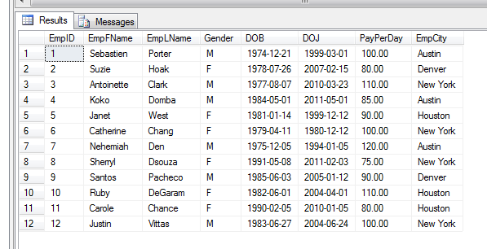
SELECT
Select all rows and all columns form the table
SELECT * FROM Employee
Warning: Avoid using * during production. It will decrease readability and retrieves unnecessary columns

Slide 50
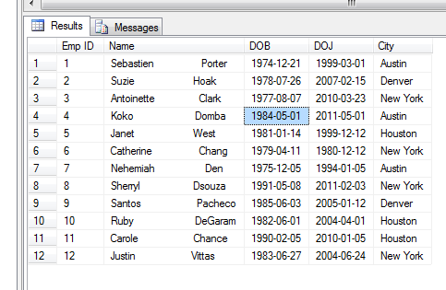
SELECT
Select all rows and specified columns with alias
SELECT EmpID AS "Emp ID", CONCAT(firstname, " ", LastName) as "Name", DOB, DOJ, EmpCity AS City FROM Employee;

Slide 51
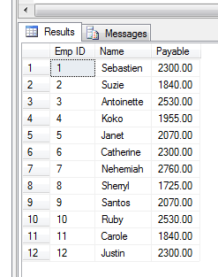
SELECT
Print the salary table for a month having 23 working days
SELECT EmpID AS "Emp ID",
EmpFName AS Name,
PayPerDay*23 AS Payable FROM Employee

Slide 52
SELECT
Usage: (Filtering records using WHERE clause)
SELECT <FieldName1> [AS <Alias1>], <FieldName2> [AS <Alias2>],
.
<FieldNamen> [AS <Aliasn>] FROM <Table Name> WHERE <Condition>
Operator | Description
= | Equal
<> | Not equal
> | Greater than
< | Less than
>= | Greater than or equal
<= | Less than or equal
IS | Compare with NULL
BETWEEN | Between an inclusive range
LIKE | Search for a pattern
IN | To specify multiple possible values for a column
EXISTS

Slide 53
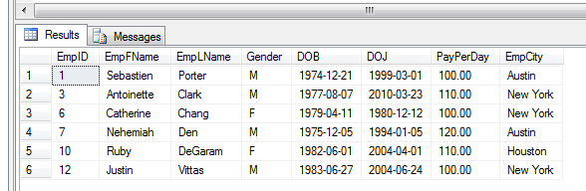
SELECT
Select Employees whose PayPerDay is more than 100 dollars
SELECT * FROM Employee WHERE PayPerDay >= 100

Slide 54
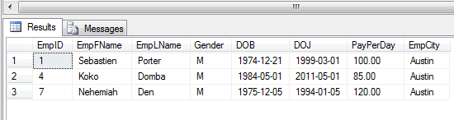
SELECT
Select Employees who are from Austin
SELECT * FROM Employee WHERE EmpCity = "Austin"

Slide 55
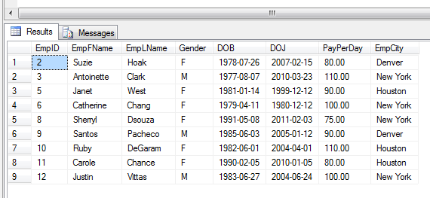
SELECT
Select Employees who are not from Austin
SELECT * FROM Employee WHERE EmpCity <> "Austin"

Slide 56
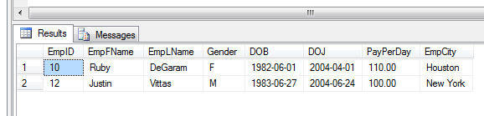
SELECT
Select Employees who joined between the fiscal year 2003-04
SELECT * FROM Employee WHERE DOJ BETWEEN STR_STR_TO_DATE("01 Oct 2003","%d %M %y") AND STR_STR_TO_DATE("30 Sep 2004","%d %M %y")
Also try…
SELECT * FROM Employee WHERE PayPerDay BETWEEN 70 AND 100
SELECT * FROM Employee WHERE PayPerDay >= 70 and PayPerDay <= 100

Slide 57
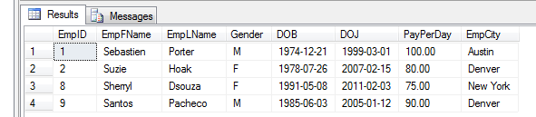
SELECT
Select Employees whose first name starting with S
SELECT * FROM Employee WHERE EmpFName LIKE "S%"
% - Zero or any INT of characters
_ - Exactly one character

Slide 58
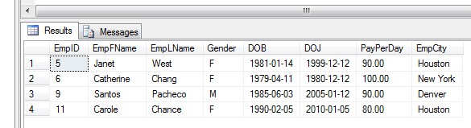
SELECT
Select Employees whose first name having second letter a
SELECT * FROM Employee WHERE EmpFName LIKE "_a%"

Slide 59
SELECT
Select Employees who are coming from Denver and Houston
SELECT EmpFName,EmpCity FROM Employee
WHERE EmpCity IN ("Denver","Houston")
EMPFNAME EMPCITY
------------------------- --------------------
Suzie Denver
Janet Houston
Santos Denver
Ruby Houston
Carole Houston

Slide 60
SELECT
SELECT (ORDER BY)
Usage: (Grouping records using ORDER BY)
SELECT <FieldName1> [AS <Alias1>], <FieldName2> [AS <Alias2>],
.
<FieldNamen> [AS <Aliasn>] FROM <Table Name>
ORDER BY
<FieldName1> [ASC|DESC]
[,<FieldName2> [ASC|DESC]
.
.
[<FieldNameN> [ASC|DESC]]

Slide 61
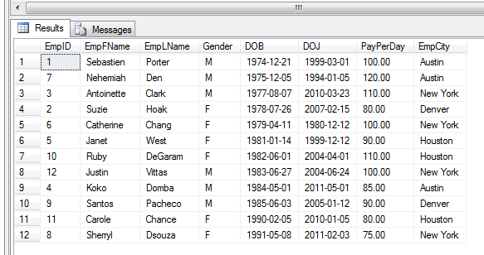
SELECT
Select Employees in the order of DOB (Eldest first)
SELECT * FROM Employee ORDER BY DOB

Slide 62
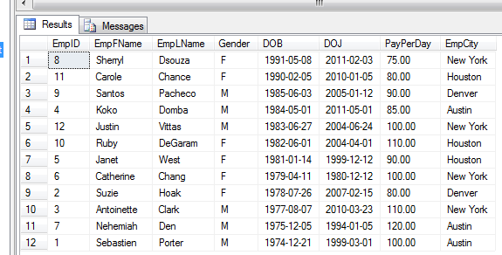
SELECT
Select Employees in the order of DOB (Youngest First)
SELECT * FROM Employee ORDER BY DOB DESC

Slide 63
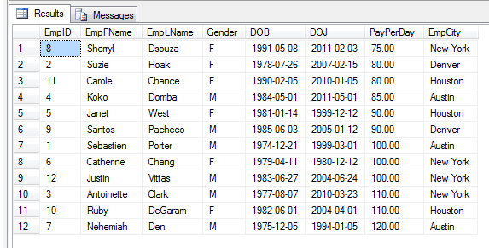
SELECT
Select Employees in the order of PayPerDay and DOJ (If PayPerDay is repeated then it uses the DOJ to select the next record)
SELECT * FROM Employee ORDER BY PayPerDay, DOJ

Slide 64
SELECT
SELECT DISTINCT
Usage: (Delist the duplicate value)
SELECT DISTINCT <FieldName1> [AS <Alias1>], <FieldName2> [AS <Alias2>],
.
<FieldNamen> [AS <Aliasn>] FROM <Table Name>

Slide 65
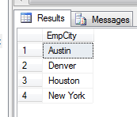
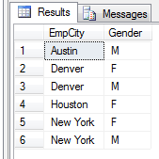
SELECT
List all the cities from which our Employees from
SELECT DISTINCT EmpCity FROM Employee
List all the cities from which our Employees from and also separate gender wise
SELECT DISTINCT EmpCity, Gender FROM Employee
From Austin and Houston, We have only MALE Employee(s)
From Denver and New York, Both MALE and FEMALE exists

Slide 66
SELECT
SELECT (Using aggregate functions)
COUNT - Count the records/Values
SUM - Applied for a INTal field, to sum the existing values
AVG - Compute the average of all the values
MIN - Find the minimum value of a field
MAX - Get the maximum

Slide 67

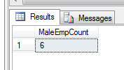

SELECT
Count all the employees we have
SELECT COUNT(*) AS EmpCount FROM Employee
Count all the Male employees we have
SELECT COUNT(*) AS MaleEmpCount FROM Employee WHERE Gender="M"
Count the total INT of cities we have employees from
SELECT COUNT(DISTINCT EmpCity) AS CityCount FROM Employee

Slide 68
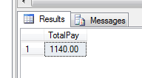


SELECT
Find total amount paid all the employees per day
SELECT SUM(PayPerDay) AS TotalPay FROM Employee
Find the average pay of male employees
SELECT AVG(PayPerDay) AS MaleAvgPay FROM Employee WHERE Gender="M"
Find the Max pay
SELECT MAX(PayPerDay) AS MaxPay FROM Employee

Slide 69
SELECT
SUB-QUERIES
A query that exists within another query is called subquery
Sub query can be in any one of the category
Single row subquery- Subquery should always return only one row
Multi row subquery- Subquery may return zero or more row
Scalar subquery- Subquery used in the column list of the main query (Subquery in the SELECT clause)
Correlated subquery- Sub query will execute for every row in the outer query. For single row and multi row subquery, sub query will execute first, only one time.
Inline subquery- Subquery in the FROM clause

Slide 70
SELECT
CREATE TABLE AccMaster( AccNo Char(5),
FName VARCHAR(25), LName VARCHAR (25),
Gender CHAR(1),
RefAccNo CHAR(5),
OpenDate DATE,
CurrBal INT(9,2),
CONSTRAINT pkAccNo PRIMARY KEY(AccNo));
CREATE TABLE AccTrans(
TransID INT(5),
TransDate DATE,
AccNo CHAR(5),
Amount INT(9,2), TransType CHAR(1),
CONSTRAINT pkTransID PRIMARY KEY(TransID),
CONSTRAINT fkAccNo FOREIGN KEY(AccNo)
REFERENCES AccMaster(AccNo));

Slide 71
SELECT
BEGIN
INSERT INTO AccMaster VALUES ("56001", "James", "Carlton", "M", NULL, STR_STR_TO_DATE("05 Oct 2005","%d%M%Y"),1500);
INSERT INTO AccMaster VALUES ("56002","Chrissy","Arlene","F","56001", STR_STR_TO_DATE("04 Jan 2006", "%d%M%Y"),1200);
INSERT INTO AccMaster VALUES ("56003","Eldridge","Powers","M","56001", STR_STR_TO_DATE("24 Jul 2006 ","%d%M%Y"),1700);
INSERT INTO AccMaster VALUES ("56004", "Hobert", "Spampinato", "M", "56002", STR_STR_TO_DATE("21 Feb 2007","%d%M%Y"),1300);
INSERT INTO AccMaster VALUES("56005","Gloria","Wright","F","56003", STR_STR_TO_DATE("07 Apr 2008","%d%M%Y"),1900);
INSERT INTO AccMaster VALUES("56006","Raj","Kumar","M","56002", STR_STR_TO_DATE("17 May 2008","%d%M%Y"),1900);

Slide 72
SELECT
INSERT INTO AccTrans VALUES (1, STR_TO_DATE("05-Oct-2005","%d%M%Y"),"56001",500,"D");
INSERT INTO AccTrans VALUES (2, STR_TO_DATE("01-Dec-2005","%d%M%Y"),"56001",1500,"D");
INSERT INTO AccTrans VALUES (3, STR_TO_DATE("04 Jan 2006","%d%M%Y"),"56002",2000,"D");
INSERT INTO AccTrans VALUES (4, STR_TO_DATE("05 Feb 2006","%d%M%Y"),"56001",400,"W");
INSERT INTO AccTrans VALUES (5, STR_TO_DATE("15 Feb 2006","%d%M%Y"),"56002",200,"W");
INSERT INTO AccTrans VALUES (6, STR_TO_DATE("24 Jul 2006","%d%M%Y"),"56003",1000,"D");
INSERT INTO AccTrans VALUES (7, STR_TO_DATE("15 Aug 2006","%d%M%Y"),"56001",100,"W");
INSERT INTO AccTrans VALUES (8, STR_TO_DATE("29 Aug 2006","%d%M%Y"),"56002",200,"D");
INSERT INTO AccTrans VALUES (9, STR_TO_DATE("12 Sep 2006","%d%M%Y"),"56003",300,"W");
INSERT INTO AccTrans VALUES (10, STR_TO_DATE("23 Dec 2006","%d%M%Y"),"56002",800,"W");
INSERT INTO AccTrans VALUES (11, STR_TO_DATE("21 Feb 2007","%d%M%Y"),"56004",2000,"D");
INSERT INTO AccTrans VALUES (12, STR_TO_DATE("10 Mar 2007","%d%M%Y"),"56004",200,"W");
INSERT INTO AccTrans VALUES (13, STR_TO_DATE("01 Apr 2008","%d%M%Y"),"56004",1000,"D");
INSERT INTO AccTrans VALUES (14, STR_TO_DATE("07 Apr 2008","%d%M%Y"),"56005",100,"D");
INSERT INTO AccTrans VALUES (15, STR_TO_DATE("01 Feb 2009","%d%M%Y"),"56004",1900,"W");
INSERT INTO AccTrans VALUES (16, STR_TO_DATE("01 May 2009","%d%M%Y"),"56005",100,"D");
INSERT INTO AccTrans VALUES (17, STR_TO_DATE("01 Jan 2010","%d%M%Y"),"56005",700,"D");

Slide 73

SELECT
Single row subquery
List the account holder with highest balance.
SELECT
AccNo,
FName,
CurrBal
FROM AccMaster
WHERE
CurrBal = (SELECT MAX(CurrBal) FROM AccMaster)
If relational operator is used the sub query should return only one row

Slide 74
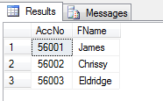
SELECT
Multi Row Subquery
Find the Customer who made at-least one transaction in the year 2006
SELECT
AccNo,
FName
FROM AccMaster
WHERE
AccNo IN (SELECT DISTINCT AccNo FROM AccTrans WHERE DATE_FORMAT(TransDate,"%Y")="2006")
Multi row subquery is identified with IN, ALL, ANY or EXISTS operator

Slide 75
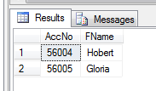
SELECT
Multi Row Subquery
Find the Customer who never made any transaction in the year 2006
SELECT
AccNo,
FName
FROM AccMaster
WHERE AccNo NOT IN
(SELECT AccNo FROM AccTrans WHERE DATE_FORMAT(TransDate,“%Y")="2006")

Slide 76
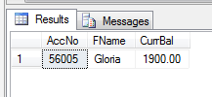
SELECT
Multi Row Subquery
Find the Customer whose account balance is greater than the account balance of all account holders who opened the account in year 2006
SELECT AccNo,FName, CurrBal FROM AccMaster WHERE CurrBal > ALL
(SELECT CurrBal FROM AccMaster WHERE DATE_FORMAT(OpenDate,“%Y")="2006")
ALL and ANY is always associated with a relational operator

Slide 77
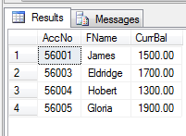
SELECT
Multi Row Subquery
Find the Customer whose account balance is greater than the account balance of any one of the account holder who opened the account in year 2006
SELECT AccNo,FName, CurrBal FROM AccMaster WHERE CurrBal > ANY
(SELECT CurrBal FROM AccMaster WHERE YEAR(OpenDate)=2006)

Slide 78
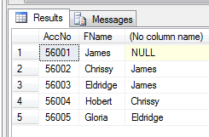
SELECT
Scalar sub-query
List all the account holders name along with the referrers name.
SELECT
A.AccNo,
A.FName,
(SELECT B.FName FROM AccMaster B WHERE A.RefAccNo = B.AccNo) AS REFERRAL
FROM AccMaster A

Slide 79
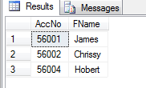
SELECT
Corelated sub-query
List all the account holders name who made a transaction on the account open date.
SELECT
M.AccNo,
M.FName
FROM AccMaster M
WHERE M.AccNo
IN (SELECT T.AccNo FROM AccTrans T WHERE T.TransDate = M.OpenDate)

Slide 80
SELECT
GROUP BY & HAVING
GROUP BY clause used to apply an aggregate function (SUM, AVG, MAX..) with respect to some field on a group of records
Example
Total transaction by each customer (both credit and debit)
SELECT AccNo, SUM(Amount) FROM AccTrans GROUP BY AccNo
ACCNO | SUM(AMOUNT)
56005 | 900
56002 | 3200
56001 | 2500
56003 | 1300
56004 | 5100

Slide 81
SELECT
GROUP BY & HAVING
Total deposits and withdrawals, separately summed
SELECT TransType, SUM(Amount) FROM AccTrans GROUP BY TransType
TRANSTYPE | SUM(AMOUNT)
W | 3900
D | 9100
Wrong Implementation of GROUP BY Clause:
SELECT TransType, SUM(Amount) FROM AccTrans GROUP BY AccNo

Slide 82
SELECT
GROUP BY & HAVING
Total deposits done by each customer
SELECT AccNo, SUM(Amount) FROM AccTrans WHERE TransType="D" GROUP BY AccNo
ACCNO | SUM(AMOUNT)
56005 | 900
56002 | 2200
56001 | 2000
56003 | 1000
56004 | 3000

Slide 83
SELECT
GROUP BY & HAVING
HAVING can be used to apply filter after aggregation
List of customers those who done total deposits more than $1500
SELECT AccNo, SUM(Amount) FROM AccTrans
WHERE TransType="D"
GROUP BY AccNo
HAVING SUM(Amount) >= 1500
ACCNO | SUM(AMOUNT)
56002 | 2200
56001 | 2000
56004 | 3000

Slide 84
SELECT
GROUP BY & HAVING
HAVING can be used to apply filter after aggregation
List of customers those who done total transaction more than $2000
SELECT AccNo, SUM(Amount) FROM AccTrans
GROUP BY AccNo
HAVING SUM(Amount) >= 2000
ACCNO | SUM(AMOUNT)
56002 | 3200
56001 | 2500
56004 | 5100

Slide 85
SELECT
GROUP BY & HAVING
Same Query ordered by the total deposit
SELECT AccNo, SUM(Amount) AS TotalDeposit FROM AccTrans
WHERE TransType="D"
GROUP BY AccNo HAVING SUM(Amount)>1500
ORDER BY TotalDeposit DESC
ACCNO | TOTALDEPOSIT
56004 | 3000
56002 | 2200
56001 | 2000

Slide 86
JOINS
JOINS
Inner Join
Cross join
Outer Join
Left Outer Join
Right Outer Join
Full Outer join

Slide 87
CROSS JOIN ….
Consider the two tables
SalesEmp
EmpID | EmpName
1 | Hansen
2 | Svendson
3 | Pettersen
OrderDetails
OrderID | OrderNo | EmpID
1 | 77895 | 3
2 | 44678 | 3
3 | 22456 | 1
4 | 24562 | 1
5 | 34762 | 7

Slide 88
CROSS JOIN ….
CREATE TABLE SalesEmp(
EmpID NUMERIC(3) PRIMARY KEY,
EmpName VARCHAR(30)
);
CREATE TABLE Orderdetails(
OrderID INT(3) PRIMARY KEY,
OrderNo INT(5),
EmployeeID NUMERIC(3),
foreign key(EmployeeID) references SalesEmp(EmpID)) ;
INSERT INTO SalesEmp VALUES(1, "Hansen");
INSERT INTO SalesEmp VALUES(2, "Svendson");
INSERT INTO SalesEmp VALUES(3, "Pettersen");
INSERT INTO Orderdetails VALUES(1, 77895, 3);
INSERT INTO Orderdetails VALUES(2, 44678, 3);
INSERT INTO Orderdetails VALUES(3, 22456, 1);
INSERT INTO Orderdetails VALUES(4, 24562, 1);
INSERT INTO Orderdetails VALUES(5, 34762, 2);

Slide 89
CROSS JOIN
SELECT * FROM SalesEmp CROSS JOIN Orderdetails
SalesEmp
EmpID | EmpName
1 | Hansen
2 | Svendson
3 | Pettersen
EmpID | EmpName | OrderID | OrderNo | EmpID
1 | Hansen | 1 | 77895 | 3
1 | Hansen | 2 | 44678 | 3
1 | Hansen | 3 | 22456 | 1
1 | Hansen | 4 | 24562 | 1
1 | Hansen | 5 | 34762 | 7
2 | Svendson | 1 | 77895 | 3
2 | Svendson | 2 | 44678 | 2
2 | Svendson | 3 | 22456 | 1
2 | Svendson | 4 | 24562 | 1
2 | Svendson | 5 | 34762 | 3
3 | Pettersen | 1 | 77895 | 3
3 | Pettersen | 2 | 44678 | 3
3 | Pettersen | 3 | 22456 | 1
3 | Pettersen | 4 | 24562 | 1
3 | Pettersen | 5 | 34762 | 2
OrderDetails
OrderID | OrderNo | EmpID
1 | 77895 | 3
2 | 44678 | 3
3 | 22456 | 1
4 | 24562 | 1
5 | 34762 | 2

Slide 90
CROSS JOIN
Compare the two following queries:
1) SELECT * FROM SalesEmp CROSS JOIN Orderdetails;
2) SELECT * FROM SalesEmp, Orderdetails;

Slide 91
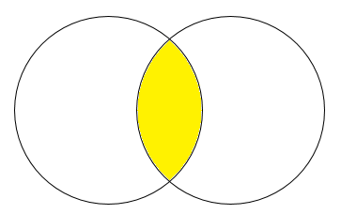
INNER JOIN
This join returns rows when there is at a match for the equated columns in both the tables.
Select only the rows whose equated columns are matching

Slide 92
INNER JOIN
SELECT SalesEmp.EmpName, OrderDetails.OrderNo FROM
SalesEmp INNER JOIN OrderDetails ON SalesEmp.EmpID=OrderDetails.EmpID
OrderNo:
34762
EmpID:
2
EmpID:
1, 3
OrderNo:
77895, 44678,
22456,
24562
We will get only this

Slide 93
INNER JOIN
SELECT SalesEmp.EmpName, OrderDetails.OrderNo FROM
SalesEmp INNER JOIN OrderDetails ON SalesEmp.EmpID=OrderDetails.EmployeeID
EmpID | EmpName | OrderID | OrderNo | EmpID
1 | Hansen | 1 | 77895 | 3
1 | Hansen | 2 | 44678 | 3
1 | Hansen | 3 | 22456 | 1
1 | Hansen | 4 | 24562 | 1
1 | Hansen | 5 | 34762 | 7
2 | Svendson | 1 | 77895 | 3
2 | Svendson | 2 | 44678 | 3
2 | Svendson | 3 | 22456 | 1
2 | Svendson | 4 | 24562 | 1
2 | Svendson | 5 | 34762 | 7
3 | Pettersen | 1 | 77895 | 3
3 | Pettersen | 2 | 44678 | 3
3 | Pettersen | 3 | 22456 | 1
3 | Pettersen | 4 | 24562 | 1
3 | Pettersen | 5 | 34762 | 7
ON Condition
No Match
No Match
Match
Match
No Match
No Match
No Match
No Match
No Match
No Match
Match
Match
No Match
No Match
No Match

Slide 94
INNER JOIN
SELECT SalesEmp.EmpName, OrderDetails.OrderNo FROM
SalesEmp INNER JOIN OrderDetails ON SalesEmp.EmpID=OrderDetails.EmployeeID
Only specified columns are selected
EmpName | OrderNo
Pettersen | 77895
Pettersen | 44678
Hansen | 22456
Hansen | 24562
Only rows with ON clause match is selected

Slide 95
INNER JOIN
Compare the following queries:
1) SELECT SalesEmp.EmpName, OrderDetails.OrderNo FROM SalesEmp INNER JOIN OrderDetails ON SalesEmp.EmpID=OrderDetails.EmployeeID
2) SELECT SalesEmp.EmpName, OrderDetails.OrderNo FROM SalesEmp, OrderDetails WHERE SalesEmp.EmpID=OrderDetails.EmployeeID -----------→ EquiJoin
3) SELECT SalesEmp.EmpName, OrderDetails.OrderNo FROM SalesEmp NATURAL JOIN OrderDetails
Also infer, what is the result of 3rd query if the equated column (EmpID) name is different from each other. (ie) EmpID in SalesEmp and EmployeeID in OrderDetails

Slide 96
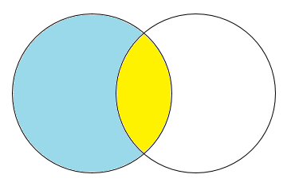
LEFT OUTER JOIN
This join returns all the rows from the left table in conjunction with the matching rows from the right table. If there are no columns matching in the right table, it returns NULL values.
If WHERE condition is included saying, right table"s column is null then, it will return only the rows which don’t have a match (Explained later)
Select (only one time) the row from the left table which don"t have a match for the equated column (Use null values for the columns specified from the right table)
Also include the rows whose equated columns are matching

Slide 97
LEFT OUTER JOIN
SELECT SalesEmp.EmpName, OrderDetails.OrderNo FROM SalesEmp LEFT OUTER JOIN OrderDetails ON SalesEmp.EmpID=OrderDetails.EmployeeID
EmpID:
2
EmpID:
1, 3
OrderNo:
77895, 44678,
22456,
24562
OrderNo:
34762
We will get both blue and yellow area. We can clearly differentiate blue and yellow rows.

Slide 98
LEFT OUTER JOIN
SELECT SalesEmp.EmpName, OrderDetails.OrderNo FROM SalesEmp LEFT OUTER JOIN OrderDetails ON SalesEmp.EmpID=OrderDetails.EmployeeID
EmpID | EmpName | OrderID | OrderNo | EmpID
1 | Hansen | 1 | 77895 | 3
1 | Hansen | 2 | 44678 | 3
1 | Hansen | 3 | 22456 | 1
1 | Hansen | 4 | 24562 | 1
1 | Hansen | 5 | 34762 | 7
2 | Svendson | 1 | 77895 | 3
2 | Svendson | 2 | 44678 | 3
2 | Svendson | 3 | 22456 | 1
2 | Svendson | 4 | 24562 | 1
2 | Svendson | 5 | 34762 | 7
3 | Pettersen | 1 | 77895 | 3
3 | Pettersen | 2 | 44678 | 3
3 | Pettersen | 3 | 22456 | 1
3 | Pettersen | 4 | 24562 | 1
3 | Pettersen | 5 | 34762 | 7
ON Condition
No Match
No Match
Match
Match
No Match
EmpID 2, Svendson Never have a match in OrderDetails
Match
Match
No Match
No Match
No Match

Slide 99
LEFT OUTER JOIN
SELECT * FROM SalesEmp LEFT OUTER JOIN OrderDetails ON SalesEmp.EmpID=OrderDetails.EmployeeID
As usual, only specified columns are selected
EmpName | OrderNo
Pettersen | 77895
Pettersen | 44678
Hansen | 22456
Hansen | 24562
Svendson | -
ON Condition
Pettersen achieved 77895
Pettersen achieved 44678
Hansen achieved 22456
Hansen achieved 24562
Svendson yet to achieve

Slide 100
LEFT OUTER JOIN
Predict the output of the query:
SELECT * FROM SalesEmp LEFT OUTER JOIN OrderDetails ON SalesEmp.EmpID=OrderDetails.EmployeeID

Slide 101
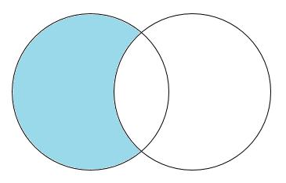
LEFT OUTER JOIN..WHERE NULL
If WHERE condition is included saying, right table"s column is null then, it will return only the rows which don’t have a match
Select (only one time) the row from the left table which don"t have a match for the equated column (Use null values for the columns specified from the right table)

Slide 102
LEFT OUTER JOIN ...WHERE NULL
SELECT SalesEmp.EmpName, OrderDetails.OrderNo FROM
SalesEmp LEFT OUTER JOIN OrderDetails ON SalesEmp.EmpID=OrderDetails.EmpID WHERE OrderDetails.EmployeeID IS NULL
EmpName | OrderNo
Svendson | -

Slide 103
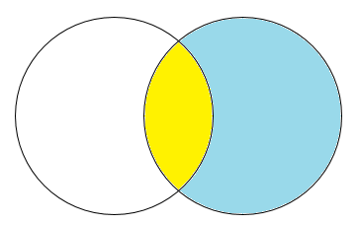
RIGHT OUTER JOIN
This join returns all the rows from the right table in conjunction with the matching rows from the left table. If there are no columns matching in the left table, it returns NULL values.
If WHERE condition is included saying, left table’s column is null then, it will return only the rows which don’t have a match (Explained later)
Also include the rows whose equated columns are matching
Select (only one time) the row from the right table which don"t have a match for the equated column (Use null values for the columns specified from the left table)

Slide 104
RIGHT OUTER JOIN ….
SELECT SalesEmp.EmpName, OrderDetails.OrderNo FROM SalesEmp RIGHT OUTER JOIN OrderDetails ON SalesEmp.EmpID=OrderDetails.EmployeeID
EmpID:
2
EmpID:
1, 3
OrderNo:
77895, 44678,
22456,
24562
OrderNo:
34762
We will get both blue and yellow area. We can clearly differentiate blue and yellow rows.

Slide 105
RIGHT OUTER JOIN ….
SELECT SalesEmp.EmpName, OrderDetails.OrderNo FROM SalesEmp RIGHT OUTER JOIN OrderDetails ON SalesEmp.EmpID=OrderDetails.EmpID
EmpID | EmpName | OrderID | OrderNo | EmpID
1 | Hansen | 1 | 77895 | 3
1 | Hansen | 2 | 44678 | 3
1 | Hansen | 3 | 22456 | 1
1 | Hansen | 4 | 24562 | 1
1 | Hansen | 5 | 34762 | 7
2 | Svendson | 1 | 77895 | 3
2 | Svendson | 2 | 44678 | 3
2 | Svendson | 3 | 22456 | 1
2 | Svendson | 4 | 24562 | 1
2 | Svendson | 5 | 34762 | 7
3 | Pettersen | 1 | 77895 | 3
3 | Pettersen | 2 | 44678 | 3
3 | Pettersen | 3 | 22456 | 1
3 | Pettersen | 4 | 24562 | 1
3 | Pettersen | 5 | 34762 | 7
ON Condition
No Match
No Match
Match
Match
No Match*
No Match
No Match
No Match
No Match
No Match*
Match
Match
No Match
No Match
No Match*

Slide 106
RIGHT OUTER JOIN ….
SELECT SalesEmp.EmpName, OrderDetails.OrderNo FROM SalesEmp RIGHT OUTER JOIN OrderDetails ON SalesEmp.EmpID=OrderDetails.EmployeeID
As usual, only specified columns are selected
EmpName | OrderNo
Hansen | 24562
Hansen | 22456
Pettersen | 44678
Pettersen | 77895
- | 34762
ON Condition
Hansen achieved 22456
Hansen achieved 24562
Pettersen achieved 44678
Pettersen achieved 77895
34762 don"t have a Sales Employee

Slide 107
RIGHT OUTER JOIN
Predict the output of the query:
SELECT * FROM SalesEmp RIGHT OUTER JOIN OrderDetails ON SalesEmp.EmpID=OrderDetails.EmployeeID

Slide 108
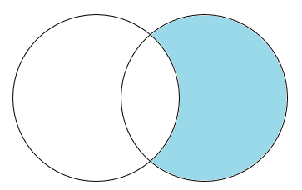
RIGHT OUTER JOIN ..WHERE NULL
If WHERE condition is included saying, left table"s column is null then, it will return only the rows which don"t have a match
EmpID:
2
EmpID:
1, 3
OrderNo:
77895, 44678,
22456,
24562
OrderNo:
34762
Select (only one time) the row from the right table which don"t have a match for the equated column (Use null values for the columns specified from the left table)

Slide 109
RIGHT OUTER JOIN ..WHERE NULL
SELECT SalesEmp.EmpName, OrderDetails.OrderNo FROM SalesEmp RIGHT OUTER JOIN OrderDetails ON SalesEmp.EmpID=OrderDetails.EmployeeID
WHERE SalesEmp.EmpID IS NULL
EmpName | OrderNo
- | 34762

Slide 110
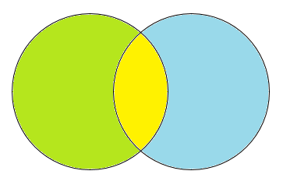
FULL OUTER JOIN
This join combines left outer join and right outer join. It returns row from either table when the conditions are met and returns null value when there is no match.
If WHERE condition is included saying, left table’s or left table’s column is null then, matching records are ignored
Also include the rows whose equated columns are matching
Select (only one time) the row from the left table which don"t have a match for the equated column (Use null values for the columns specified from the right table)
Select (only one time) the row from the right table which don"t have a match for the equated column (Use null values for the columns specified from the left table)

Slide 111
FULL OUTER JOIN
SELECT EmpName, OrderNo FROM SalesEmp
FULL JOIN OrderDetails
EmpName | OrderNo
Pettersen | 77895
Pettersen | 44678
Hansen | 22456
Hansen | 24562
- | 34762
Svendson | -

Slide 112
EQUI JOIN
List all the Transactions and also include the account holder name.
SELECT A.TransID ,A.AccNo,B.FName,A.TransType,A.Amount
FROM AccTrans A,AccMaster B
WHERE A.AccNo=B.AccNo
SELECT AccTrans.TransID ,AccTrans.AccNo,AccMaster.FName,AccTrans.TransType,AccTrans.Amount
FROM AccTrans ,AccMaster
WHERE AccTrans.AccNo=AccMaster.AccNo
SELECT TransID ,AccTrans.AccNo,FName,TransType,Amount
FROM AccTrans ,AccMaster
WHERE AccTrans.AccNo=AccMaster.AccNo

Slide 113


UNION
Consider Two Tables
CREATE TABLE Table1 (ID INT(3), NAME VARCHAR(30))
INSERT INTO Table1 VALUES(101,"A");
INSERT INTO Table1 VALUES(103,"C");
INSERT INTO Table1 VALUES(107,"G");
CREATE TABLE Table2 (ID INT(3), NAME VARCHAR(30))
INSERT INTO Table2 VALUES(102,"B");
INSERT INTO Table2 VALUES(103,"C");
INSERT INTO Table2 VALUES(107,"H");
SELECT * FROM Table1
SELECT * FROM Table2
Notes:
Product_Old table set up
CREATE TABLE Product_Old(PID INT(4), Name varchar2(30), Qty INT(2), Unit_Price INT(6,2));
INSERT INTO Product_Old VALUES(11,"Jacket",10,2000);
INSERT INTO Product_Old VALUES(2,"T-Shirt",10,300);
INSERT INTO Product_Old VALUES(12,"Hanky",5,25);
INSERT INTO Product_Old VALUES(4,"Trousers",20,900);
INSERT INTO Product_Old VALUES(5,"Skirt",10,200);

Slide 114
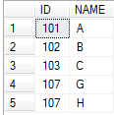
UNION
SELECT * FROM Table1 UNION SELECT * FROM Table2
Or
SELECT ID,NAME FROM Table1
UNION
SELECT ID,NAME FROM Table2
No Duplicate rows & records sorted by first column
U
Notes:
Product_Old table set up
CREATE TABLE Product_Old(PID INT(4), Name varchar2(30), Qty INT(2), Unit_Price INT(6,2));
INSERT INTO Product_Old VALUES(11,"Jacket",10,2000);
INSERT INTO Product_Old VALUES(2,"T-Shirt",10,300);
INSERT INTO Product_Old VALUES(12,"Hanky",5,25);
INSERT INTO Product_Old VALUES(4,"Trousers",20,900);
INSERT INTO Product_Old VALUES(5,"Skirt",10,200);

Slide 115
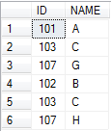
UNION ALL
SELECT * FROM Table1 UNION ALL SELECT * FROM Table2
Or
Duplicate rows also included & records not sorted
SELECT ID,NAME FROM Table1
UNION ALL
SELECT ID,NAME FROM Table2
U
Notes:
Product_Old table set up
CREATE TABLE Product_Old(PID INT(4), Name varchar2(30), Qty INT(2), Unit_Price INT(6,2));
INSERT INTO Product_Old VALUES(11,"Jacket",10,2000);
INSERT INTO Product_Old VALUES(2,"T-Shirt",10,300);
INSERT INTO Product_Old VALUES(12,"Hanky",5,25);
INSERT INTO Product_Old VALUES(4,"Trousers",20,900);
INSERT INTO Product_Old VALUES(5,"Skirt",10,200);

Slide 116
Practical Learning(I)
Customer
SalesEmp
ID | Name | Age | Salary
1 | Abe | 61 | 140000
2 | Bob | 34 | 44000
5 | Chris | 34 | 40000
7 | Dan | 41 | 52000
8 | Ken | 57 | 115000
11 | Joe | 38 | 38000
ID | Name | City | Industry Type
4 | Samsonic | pleasant | J
6 | Panasung | oaktown | J
7 | Samony | jackson | B
9 | Orange | Jackson | B
OrderDetails
INT | order_date | cust_id | salesperson_id | Amount
10 | 8/2/96 | 4 | 2 | 540
20 | 1/30/99 | 4 | 8 | 1800
30 | 7/14/95 | 9 | 1 | 460
40 | 1/29/98 | 7 | 2 | 2400
50 | 2/3/98 | 6 | 7 | 600
60 | 3/2/98 | 6 | 7 | 720
70 | 5/6/98 | 9 | 7 | 150

Slide 117
Practical Learning(I)
Write a query to find…
a. The names of all salespeople that have an order with Samsonic. b. The names of all salespeople that do not have any order with Samsonic. c. The names of salespeople that have 2 or more OrderDetails.

Slide 118
Practical Learning(II)
User
UserID
UserName
PhoneNum
LoginHistory
UserID
LoginDate
1. Write a SQL query that returns the name, phone INT and most recent date for any user that has logged in over the last 30 days
2. Write a SQL query to determine which user had never logged in before

Slide 119
VIEWS
View is a virtual table that contains columns from one or more tables
View is an precompiled object, which holds a query.
It can be used as a table for another query.
Used to reduce the complexity of large queries
Improves security, as the DBA can create a VIEW and provide access only to the required column in table.
CREATE VIEW EmpOrderDetails
AS
SELECT SalesEmp.EmpName, OrderDetails.OrderNo FROM SalesEmp INNER JOIN OrderDetails ON SalesEmp.EmpID=OrderDetails.EmployeeID

Slide 120
VIEWS
Select VIEW like a table
SalesEmp
EmpID | EmpName
1 | Hansen
2 | Svendson
3 | Pettersen
OrderDetails
OrderID | OrderNo | EmpID
1 | 77895 | 3
2 | 44678 | 3
3 | 22456 | 1
4 | 24562 | 1
5 | 34762 | 7
SELECT * FROM EmpOrderDetails
EmpName | OrderNo
Hansen | 22456
Hansen | 24562
Pettersen | 77895
Pettersen | 44678

Slide 121
INDEX
Indexes are background objects that are used to retrieve the data fast
Oracle uses B Tree index by default.
Create index only for the columns which are involved in where clause.
Index is automatically created for the primary key column.
Usage:
CREATE INDEX <Index Name> ON <TableName>
(<Field1> [ASC|DESC],
<Field2>[ASC|DESC],
…
<Fieldn>[ASC|DESC])
Example
CREATE INDEX IdxEmpName ON Emp(EmpLName, EmpFName)
DROP an INDEX
DROP INDEX <Index Name> ON <Table Name>

Slide 122
STORED PROCEDURE
A procedure is a collection of pre-compiled SQL statements stored inside the database.
Stored Procedure increases the performance of the applications.
Stored procedure reduces the traffic between application and database server. Stored procedures are reusable and transparent to any applications.
A procedure is always secure.
DELIMITER &&
CREATE PROCEDURE procedure_name [[IN | OUT | INOUT] parameter_name datatype [, parameter datatype]) ]
BEGIN
Declaration_section
Executable_section
END &&
DELIMITER ;

Slide 123
STORED PROCEDURE
N parameter
It is the default mode. It takes a parameter as input, such as an attribute. When we define it, the calling program has to pass an argument to the stored procedure. This parameter's value is always protected.
OUT parameters
It is used to pass a parameter as output. Its value can be changed inside the stored procedure, and the changed (new) value is passed back to the calling program. It is noted that a procedure cannot access the OUT parameter's initial value when it starts.
INOUT parameters
It is a combination of IN and OUT parameters. It means the calling program can pass the argument, and the procedure can modify the INOUT parameter, and then passes the new value back to the calling program.

Slide 124
STORED PROCEDURE
DELIMITER &&
CREATE PROCEDURE get_student ()
BEGIN
SELECT * FROM student_info WHERE marks > 70;
SELECT COUNT(stud_code) AS Total_Student FROM student_info;
END &&
DELIMITER ;
CALL get_student();

Slide 125
STORED PROCEDURE
DELIMITER &&
CREATE PROCEDURE get_customers (IN var1 int)
BEGIN
SELECT * FROM customers where customerid=var1;
END &&
DELIMITER ;
call get_customers(222);

Slide 126
STORED PROCEDURE
DELIMITER &&
CREATE PROCEDURE get_customers (IN var1 int)
BEGIN
SELECT * FROM customers where customerid=var1;
END &&
DELIMITER ;
call get_customers(222);

Slide 127
STORED PROCEDURE
DELIMITER &&
CREATE PROCEDURE display_orderdetail (INOUT id1 int)
BEGIN
SELECT ordernumber INTO id1 FROM orders where id=id1;
END &&
DELIMITER ;
mysql> CALL display_max_mark(@M);
mysql> SELECT @M;

Slide 128
STORED PROCEDURE
DELIMITER &&
CREATE PROCEDURE display_marks (INOUT var1 INT)
BEGIN
SELECT marks INTO var1 FROM student_info WHERE stud_id = var1;
END &&
DELIMITER ;
mysql> SET @M = '3';
mysql> CALL display_marks(@M);
mysql> SELECT @M;

